Slide 1
Monthly Financial Report – April 2021

Slide 2
Cash Balance Comparison
$4.1 million more than last April – due to mainly due to phase-in of income tax collections.

Slide 3
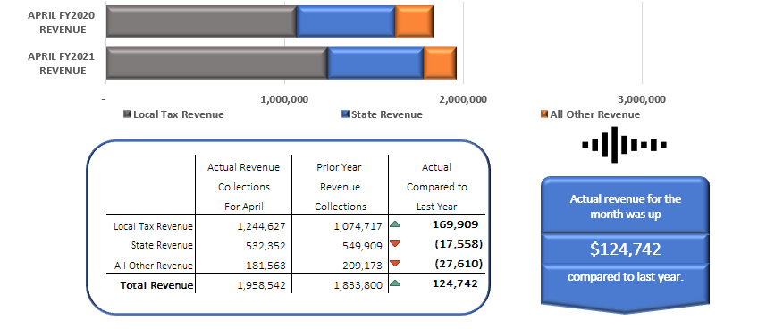
April Revenue Collections Compared to Prior Year
Higher April Income Tax Payment this year.

Slide 4
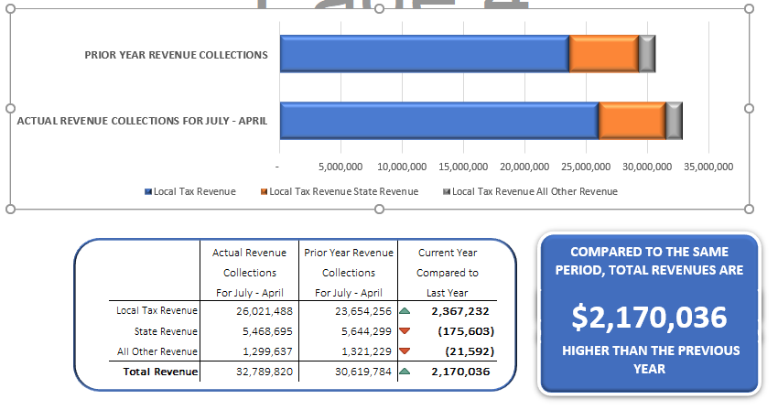
YTD Revenue Collections Compared to Prior Year
Local tax: income tax phase in
State revenue: timing of reductions
All other revenue: lower return of advances, lower interest earnings, BWC refunds

Slide 5
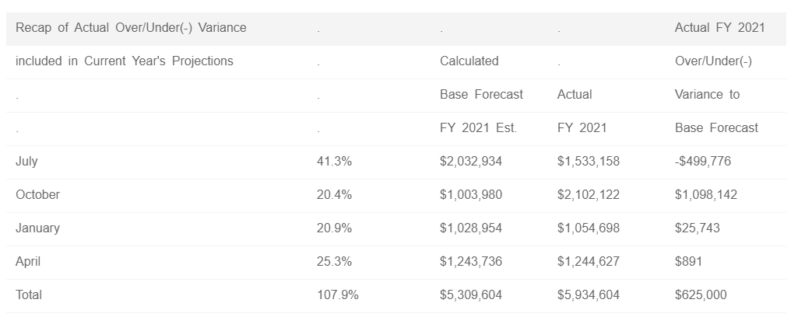
YTD Income Tax Collections Compared to Estimate
The income tax is $625,000 above estimates derived from ODT timeline estimates after being generally on target the first five payments and despite COVID impacts

Slide 6
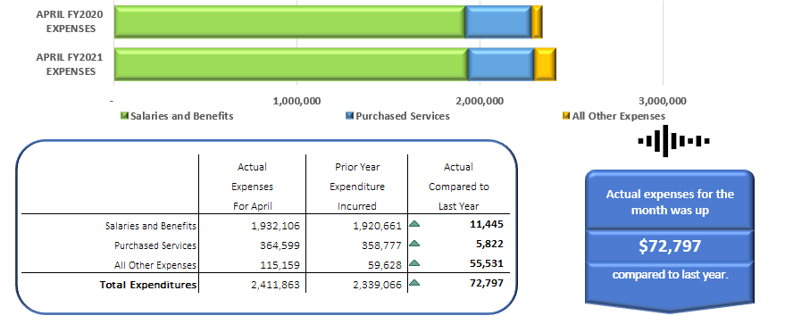
April Expenditures Compared to Prior Year

Slide 7
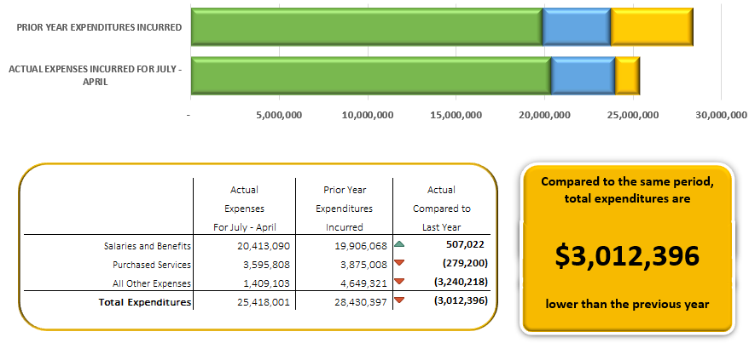
YTD Expenditures Compared to Prior Year
Primarily due to the athletic complex transfer last year
Salaries & Benefits: duplicate insurance payment in July due to software conversion
Purchased Services: likely to remain below last year and below estimate
All Other Expenditures: no transfer for athletic complex this year

Slide 8
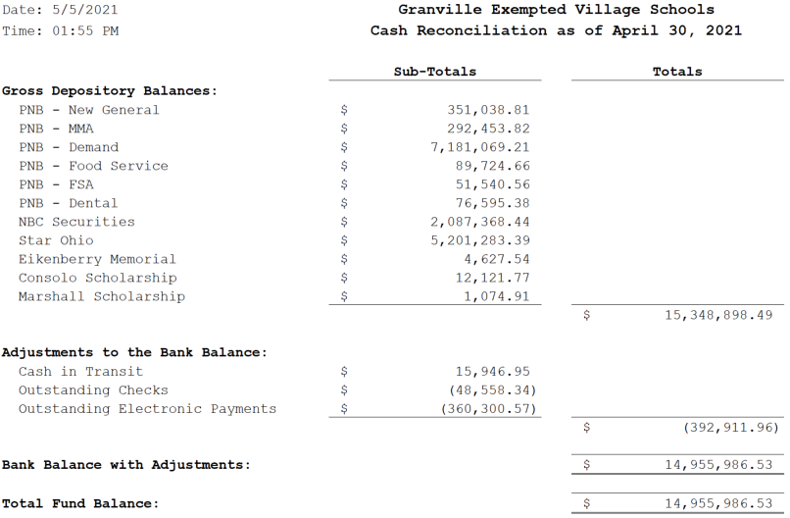
Cash Reconciliation

